Slide 1
Dynamic Neural Networks for Enhanced Air Quality Forecasting
23442 Muhammad Zubair Khan

Slide 2
Team Details and 700 Numbers
Abhiroopsudansh Karengula 700758658
Lakshmi Sai Harshini Kambampati 700759673
Lakshmi Narayana Velpula 700756288
Hemanth Kumar Panikala 700744924

Slide 3
Abstract
This study pioneers a dynamic approach to air quality forecasting, integrating Convolutional Neural Networks (CNNs), Recurrent Neural Networks (RNNs), and Long Short-Term Memory (LSTM) networks to address public health and environmental policy needs.
These models excel in analyzing the complex temporal sequences and spatial distributions affecting air quality, utilizing comprehensive datasets from sources like the World Air Quality Index and the United States Environmental Protection Agency.
By capturing the nuances of temporal and spatial variations in pollutant levels, our approach enhances the ability to accurately forecast air quality across diverse geographic and temporal landscapes.

Slide 4
Introduction
The necessity for accurate and dynamic air quality forecasting has escalated, driven by its critical impact on public health, ecosystems, and policy.
Traditional forecasting methods, primarily based on static models, struggle to adapt to the dynamic environmental variables affecting air quality.
These methods often fail in real-world applications, where sudden changes in pollutants due to human activities or natural events are common.
Consequently, there's an urgent demand for forecasting tools that can dynamically adapt to changing environmental conditions, offering a more reliable basis for health advisories and policy-making in response to air quality fluctuations.

Slide 5
Motivation
Urgent Need for Precision: Recognizing air pollution as a global health crisis requires forecasting methods that can accurately predict fluctuating air quality levels.
Limitations of Current Models: Traditional forecasting models fall short, unable to adapt to rapid environmental changes caused by human and natural activities.
Promise of Deep Learning: The integration of CNNs, RNNs, and LSTMs offers a new frontier in dynamically adapting forecasting tools, capable of handling complex data patterns in real-time.
Overcoming Predictive Challenges: This research aims to address the unpredictability of air quality, developing models that can swiftly adapt to sudden environmental shifts, ensuring more reliable forecasts.
Impact on Policy and Health: Enhanced forecasting accuracy will empower policymakers and health officials with timely data, enabling proactive measures against pollution’s adverse effects.

Slide 6
Objectives
Develop Adaptive Models: To create advanced neural network architectures that adjust in real-time to changing air quality conditions, improving prediction accuracy.
Tackle Domain Shift: To devise strategies that enable models to generalize across different environmental settings, ensuring consistent performance in varied geographic regions.
Implement Continual Learning: To incorporate mechanisms that allow models to learn incrementally, absorbing new data while retaining accuracy on previously learned information, preventing catastrophic forgetting.
Ensure Real-time Adaptability: To design models capable of integrating real-time environmental data for immediate forecasting, crucial for responding to sudden air quality changes.

Slide 7
Problem Statement
The core challenge addressed by our study is the significant gap in current air quality forecasting models' ability to adapt to the rapidly changing and unpredictable nature of atmospheric conditions. Traditional forecasting methods, relying heavily on static historical data, are often inadequate in real-time environmental assessment, struggling to accommodate sudden shifts in air quality due to industrial emissions, traffic patterns, weather events, and other dynamic factors. This inadequacy leads to less reliable forecasts, hindering timely decision-making for public health and environmental management. Our research seeks to revolutionize air quality forecasting by employing dynamic neural networks that can process complex spatial and temporal data, offering a more accurate, adaptable, and responsive tool for environmental monitoring and policy support.

Slide 8
Proposed solution
Our proposed solution to the challenge of accurate and adaptable air quality forecasting involves the development and integration of advanced dynamic neural network architectures—specifically, Convolutional Neural Networks (CNNs), Recurrent Neural Networks (RNNs), and Long Short-Term Memory (LSTM) networks. These models are designed to effectively analyze and interpret the complex interplay of spatial and temporal data influencing air quality. The solution encompasses several key components:
Data Collection and Processing: Utilizing comprehensive datasets from global air quality monitoring networks, including real-time and historical measurements of pollutants and meteorological conditions. This step ensures the models are trained on diverse environmental data.

Slide 9
Proposed solution cont.
Dynamic Neural Network Architectures: Developing adaptive models that leverage CNNs for analyzing spatial patterns, and RNNs/LSTMs for capturing temporal dependencies in air quality data. This hybrid approach aims to provide a nuanced understanding of how various factors impact air quality across different times and locations.
Real-time Data Integration: Incorporating live environmental data feeds into the models to enable real-time forecasting. This capability allows the models to adapt to new information, ensuring forecasts remain accurate and relevant.
Adaptive Learning and Generalization: Implementing strategies to mitigate the effects of domain shift, enabling the models to perform consistently across different geographic regions and environmental conditions. This includes the application of transfer learning and domain adaptation techniques.

Slide 10
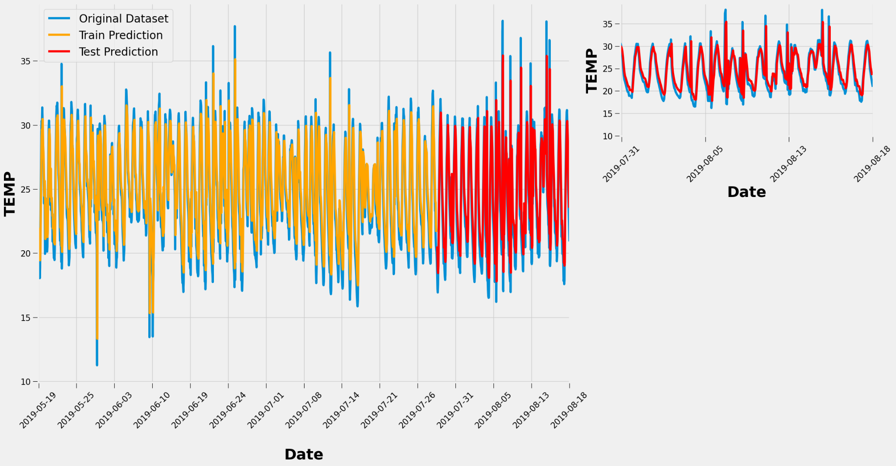
Results
Temperature and Humidity Prediction Accuracy: The LSTM model showcased remarkable predictive capabilities for humidity levels, essential for assessing air quality. Simultaneously, it demonstrated a nuanced understanding of temperature fluctuations, critical factors in air quality dynamics. These results underline the LSTM's strength in handling temporal data, crucial for comprehensive air quality forecasting.

Slide 11
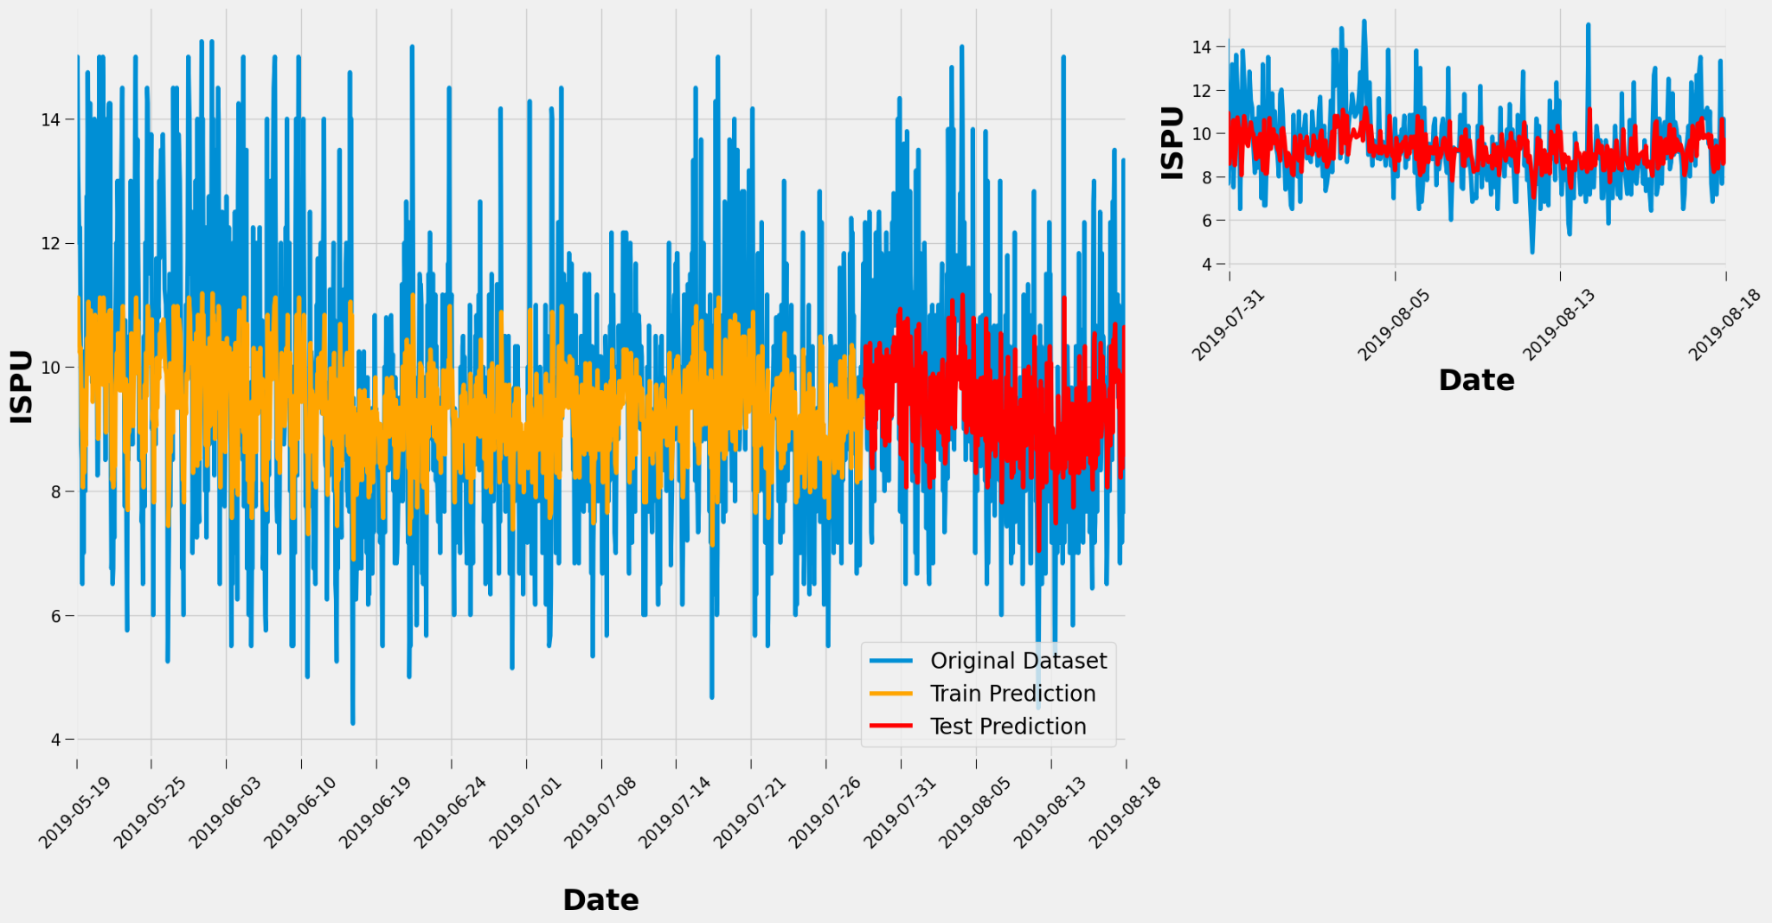
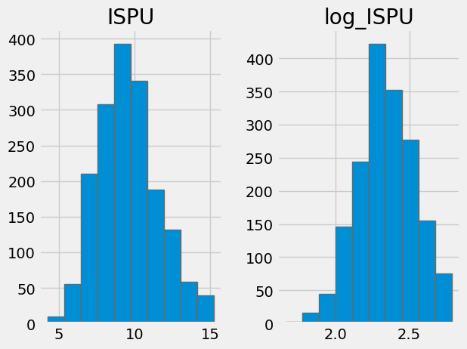
Results
Handling Volatile Environmental Conditions: The study's models, particularly the CNN, adeptly predicted the Index of Air Pollution (ISPU) values, reflecting their capacity to process spatial information related to air quality. This capability is instrumental in adapting to sudden environmental changes, such as urban pollution spikes and shifts in weather patterns, showcasing the models' robustness and versatility.

Slide 12
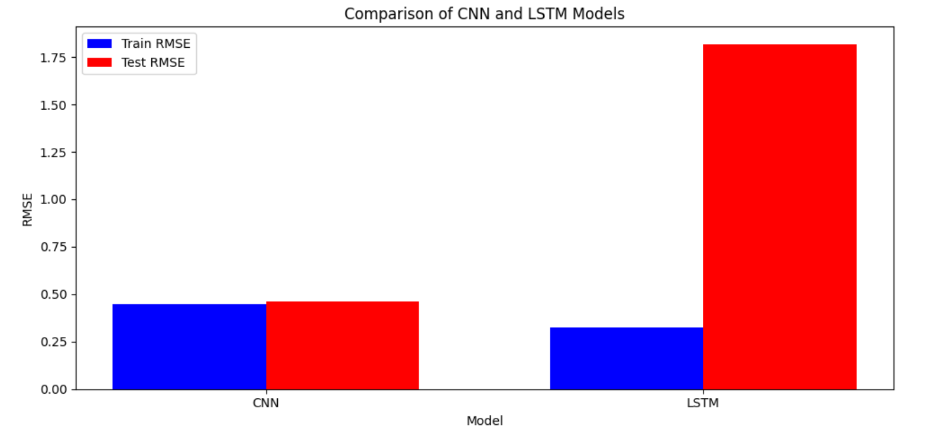
Results
In comparing the performance of CNN and LSTM models, our study observed a notable difference in how each model handles overfitting, a critical aspect in the accuracy and reliability of air quality forecasting.
The LSTM model, while demonstrating superior ability to capture temporal dependencies crucial for predicting variables like humidity and temperature, showed a tendency towards overfitting, as evidenced by lower training loss coupled with higher validation loss over successive epochs.
In contrast, the CNN model, adept at processing spatial data for predicting the Index of Air Pollution (ISPU), maintained a more consistent performance between training and testing phases.
This contrast underscores the importance of employing regularization, dropout, and cross-validation techniques to mitigate overfitting in LSTM models, ensuring the robustness and generalizability of air quality forecasts.

Slide 13
Individual Contribution
Abhiroopsudansh Karengula
Lead on Model Development: Spearheaded the integration and optimization of Convolutional Neural Networks (CNNs), focusing on enhancing the spatial data analysis capabilities crucial for interpreting complex environmental patterns affecting air quality.
Data Analysis Expertise: Played a key role in analyzing the outcomes of the CNN models, particularly in their application to spatially related air quality indicators, ensuring the models' adaptability and accuracy in forecasting.
Lakshmi Sai Harshini Kambampati
Temporal Data Analysis: Focused on the development and fine-tuning of Long Short-Term Memory (LSTM) networks, aiming to accurately capture the temporal dynamics of air quality indicators like humidity and temperature fluctuations.
Overfitting Mitigation Strategies: Implemented advanced techniques to prevent overfitting in LSTM models, enhancing their generalization ability across different environmental conditions and datasets.

Slide 14
Individual Contribution
Lakshmi Narayana Velpula
Data Collection and Preprocessing: Led the efforts in gathering comprehensive environmental datasets, including real-time and historical measurements from global monitoring sources, and prepared this data for model training and validation.
Feature Engineering: Applied expertise in feature engineering to identify and select the most predictive variables for air quality, optimizing the input data for both CNN and LSTM models to improve forecasting accuracy.
Hemanth Kumar Panikala
Integration and System Testing: Oversaw the integration of CNN, RNN, and LSTM models into a unified forecasting framework, ensuring seamless operation and data flow between components.
Real-time Data Integration: Pioneered the incorporation of real-time environmental data into the predictive models, enabling dynamic forecasting capabilities that can respond promptly to sudden air quality changes.

Slide 15
References
Zhu, Y., Xie, J., Huang, F., & Cao, Y. (2019). "Deep learning integrated with convolutional neural networks and long short-term memory networks for air quality prediction." Journal of Cleaner Production, 220, 355-365.
Li, X., Peng, L., Yao, X., Cui, S., & Hu, Y. (2020). "Using graph convolutional networks for air quality predictions in smart cities." IEEE Internet of Things Journal, 7(10), 9225-9233.
Wang, J., Zhu, L., & Liu, X. (2021). "A transfer learning approach for air quality forecasting with deep neural networks." Environmental Research, 194, 110690.
Park, H.S., Kim, S.H., & Kim, N. (2019). "Air quality prediction using recurrent neural networks." IEEE Access, 7, 118164-118173.
Guo, H., Chen, Q., Jin, X., & Xiang, Y. (2020). "Attention-based spatial-temporal graph convolutional networks for traffic flow forecasting." Transportation Research Part C: Emerging Technologies, 115, 102622.
Singh, K.P., Gupta, S., & Rai, P. (2021). "Advancements in air quality prediction models using machine learning and deep learning approaches: A review." Atmospheric Environment, 246, 118134.
He, Z., Jin, M., & Du, Y. (2018). "Real-time air quality forecasting using deep learning." Atmospheric Environment, 185, 84-93.

